Slide 1
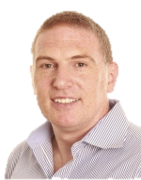
Blended Learning – Adobe Connect Session
TITLE: EXISTING & EMERGING TECHNOLOGIES – AdoBe Connect
PRESENTER: COLM DUNPHY
DATE/TIME: THURSDAY 11 Feb 2015, 17:00 GMT
Notes:
Prep:
Background
Stand for laptop
headphones
lamp
second laptop with music
main laptop with Firefox
Config
Start Webcam
Sound
Mic
Meeting | Record Meeting
SAY Hi in Chat.
Go through the participants names
Ask them to enter where they are e.g. office / class/ home
Share Todays Files in Files Pod
Paddy Cosgrove + Mirium O Callaghan
Pointer Selecttion Delete to clear notes
Poll - Broadcast Results
SAY THANKS FOR JOINING OUR SESSION

Slide 2
1. WELCOME
Say Hi in chat
*** Colm Remember to record

Slide 3
1.1 Session Format
Welcome (5 mins)
INTRODUCTION TO Adobe Connect (20 mins)
Q&A on TODOs (20 mins)

Slide 4

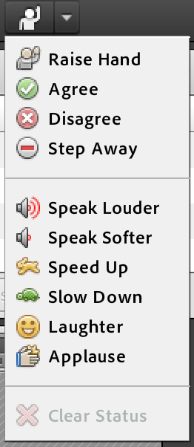
1.2 STATUS
In a virtual session, the lecturer can’t see you
Use your STATUS to:
Interrupt or Ask a question
Agree or Disagree
Indicate that your stepping out or returning
Ask the lecturer to speak louder/softer
Ask the lecturer to speed up / down
Indicate laughter
Show appreciation
WebCam is on
Mic is on
Sound is on

Slide 5
2. INTRODUCTION
Adobe Connect

Slide 6
Browsers (Nov 2015)
When you launch Adobe Connect it checks, downloads, installs and enables an Adobe Flash / Connect Addin for your browser
Due to a prardigm shift in technology for media use on the internet recently, you may find issues running the Connect Addin
Our testing found that right now you should use Firefox to minimize issues
Firefox
https://helpx.adobe.com/flash-player/kb/enabling-flash-player-firefox.html
Internet Explorer
https://forums.adobe.com/thread/885448
Chrome
https://helpx.adobe.com/flash-player/kb/enabling-flash-player-chrome.html
Safari
https://helpx.adobe.com/flash-player/kb/enabling-flash-player-safari.html

Slide 7
ADOBE CONNECT - REQUIREMENTS
PRESENTER (LECTURER)
Computer with an Adobe Flash enabled (Adobe Connect enabled) browser, webcam & mic
Broadband capable of streaming video
Nice background, lighting, makeup, wardrobe, etc.
Ideally another person
HOST (FACILATATOR) – field questions / assist with the technology
PARTICIPANT (STUDENT)
Computer with an Adobe Flash enabled (Adobe Connect enabled) browser, headphones or speakers
Broadband capable of streaming video

Slide 8
Adobe Connect - Users
HOST
Lecturer / coordinator
PRESENTER
Lecturer
PARTICPANT
Student
ME
YOU

Slide 9
PRESENTING

Slide 10
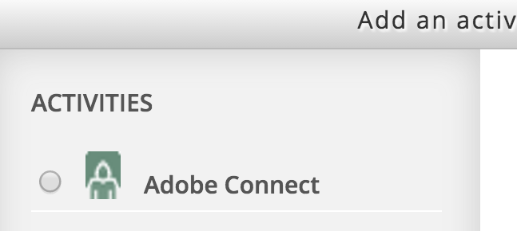
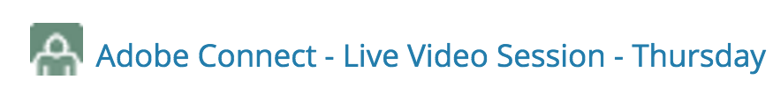
Meetings
Contact CTEL to get an Adobe Connect licence and add Adobe Connect to your Moodle Activities
In Moodle create a new Activity
Select Adobe Connect
Enter Meeting Title, Meeting URL, info, date/time, public/private
Particpants and Presenters join the meeting by clicking on the activity in Moodle
or use the URL for the meeting room
If the meeting is recorded, it will automatically be made available afterwards to participants

Slide 11
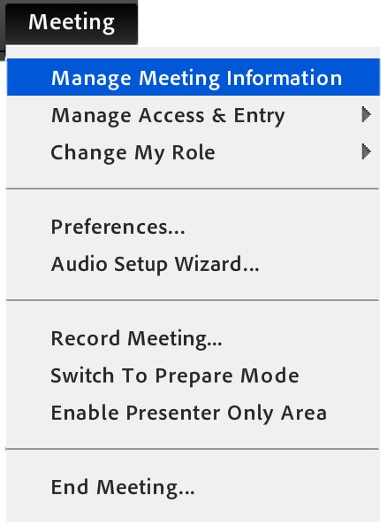
Meetings 2
Record a Meeting
To share asynchronously later,
PREPARE MODE
PREPARE – so you can upload files and have them ready
PRESENTER ONLY AREA
For speaker notes etc
Select Manage Meeting Information to
share the URL
Edit/Delete Recordings

Slide 12
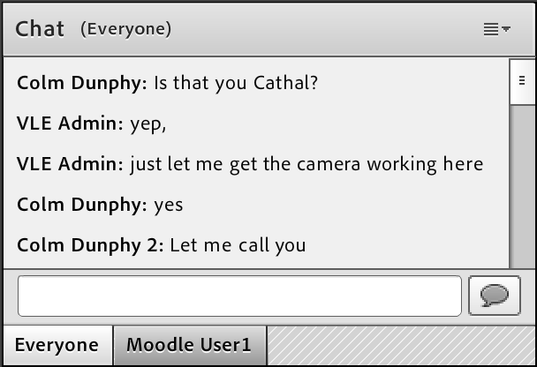
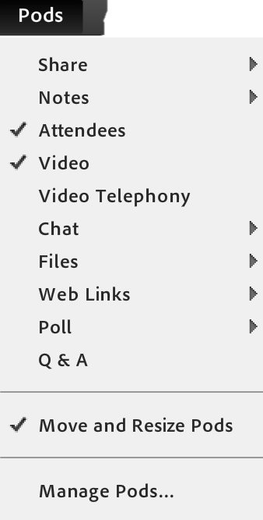
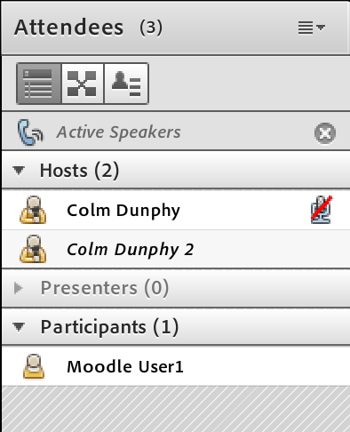
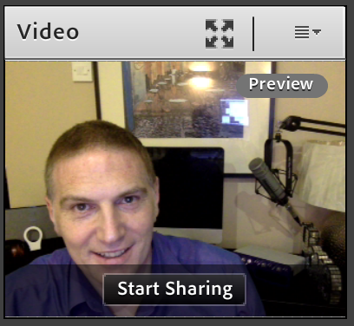
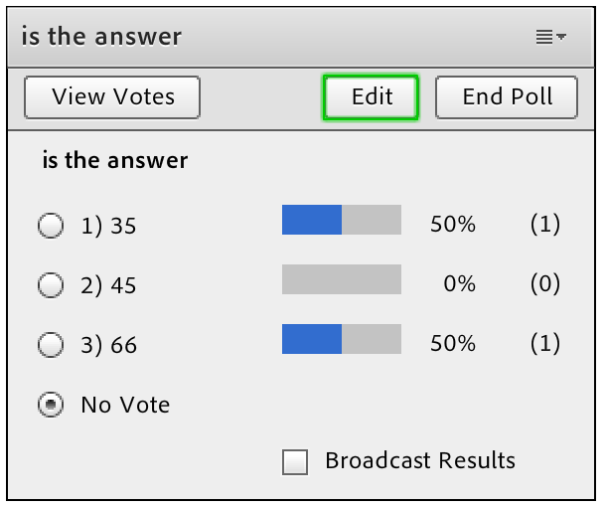
Pods (panels or windows)
Explore each pod’s menu
Use SHARE to deliver files &
videos to students (virtual handouts)
as detail is lost in streaming
Notes:
CHAT – enable audience to ask questions, comment or discuss

Slide 13
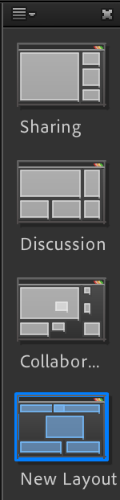
Layouts
Arrangement of pods to make presenting smoother
Plan your meeting. Build arrangements to suit

Slide 14
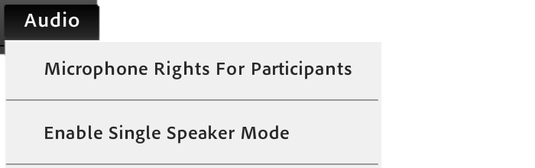
Audio
Single Speaker mode helps reduce feedback and people talking over one another. “Pass the mic”
NOTE: A particpant needs to be promoted to presenter in order to use the mic in this mode
Mic Rights for Particpants enables everyone to be able to speak

Slide 15
TIPS & ISSUES
Best if participants just use:
Status,
Polls,
Chat not mic/webcam
ISSUES:
FLASH
Broadband
Sound
Light
Feedback
Background
Computer
Webcam
Mic
Headphones

Slide 16
3. Questions & Answers
How did you get on with your TODOs?

Slide 17
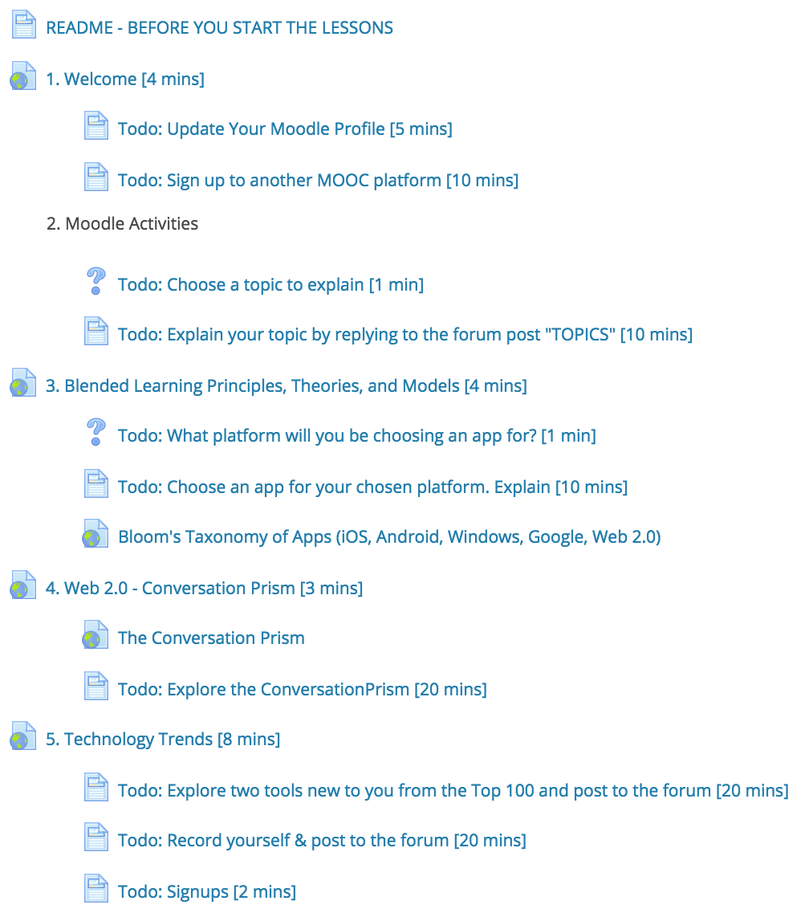
TASKS BEFORE CLASS
1
Lets run some POLLs
2
3
4
5
6
7
8

Slide 18
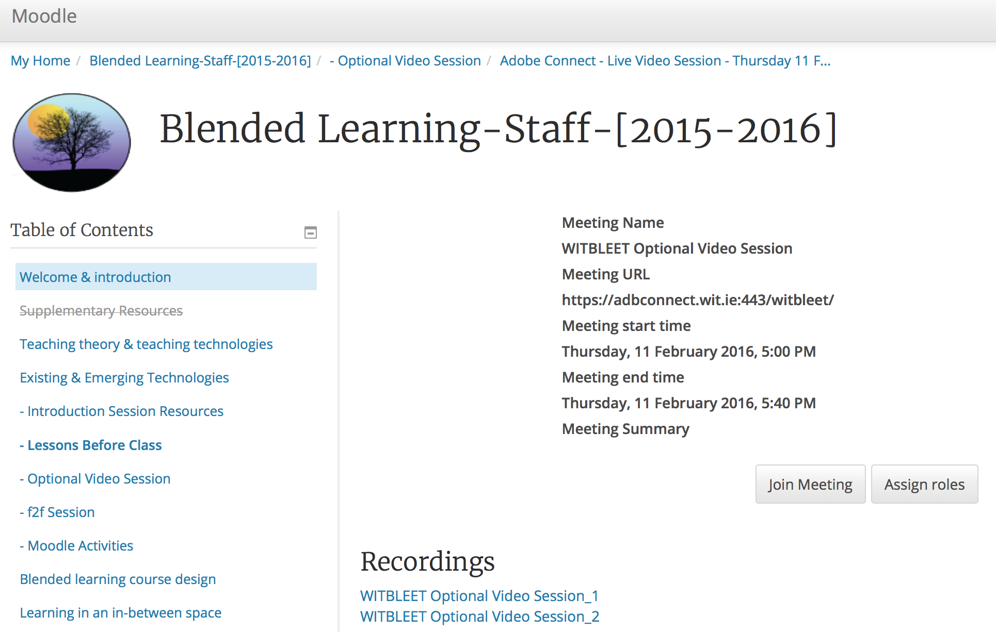
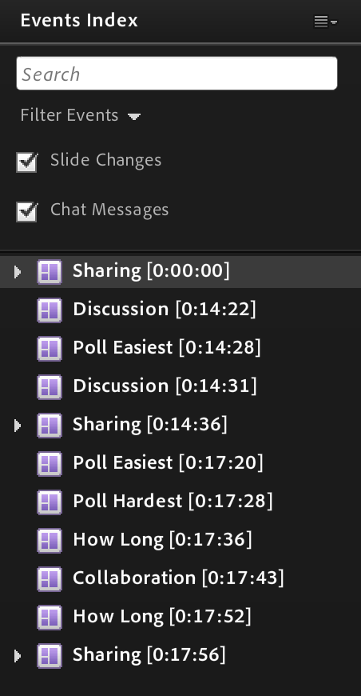
RECORDINGS
Notes:
Recordings are added to the Adobe Connect Activity in Moodle by default but only participants get to see them.
The recording is automatically broken up with an index

Slide 19
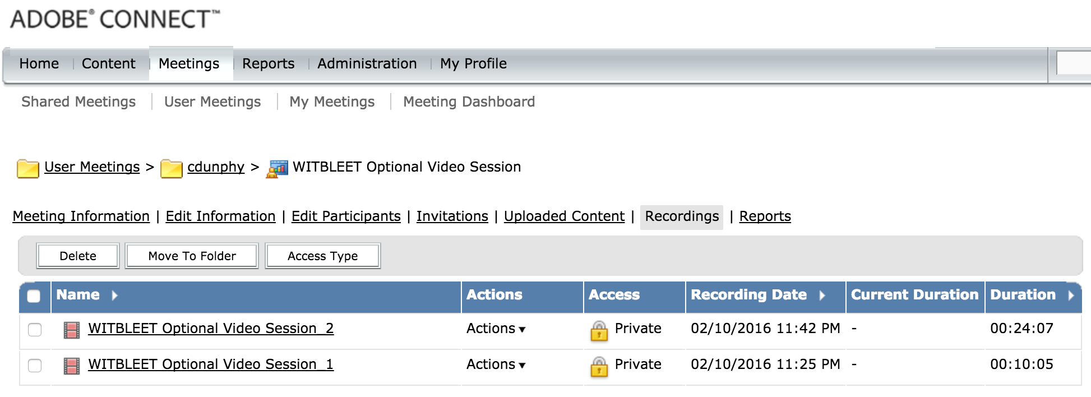

RECORDINGS
DELETE Recording
SAVES Offline Recording in FLV format
Notes:
You can Delete recordings, or save an offline version (FLV)

Slide 20
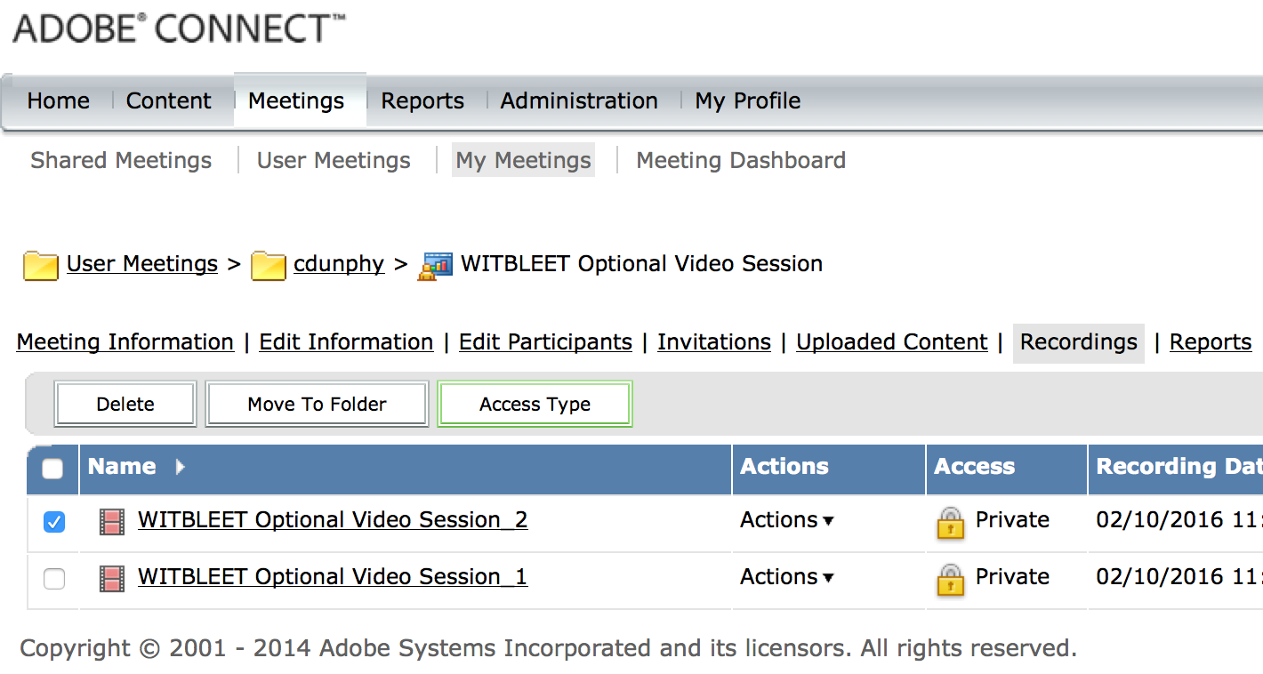
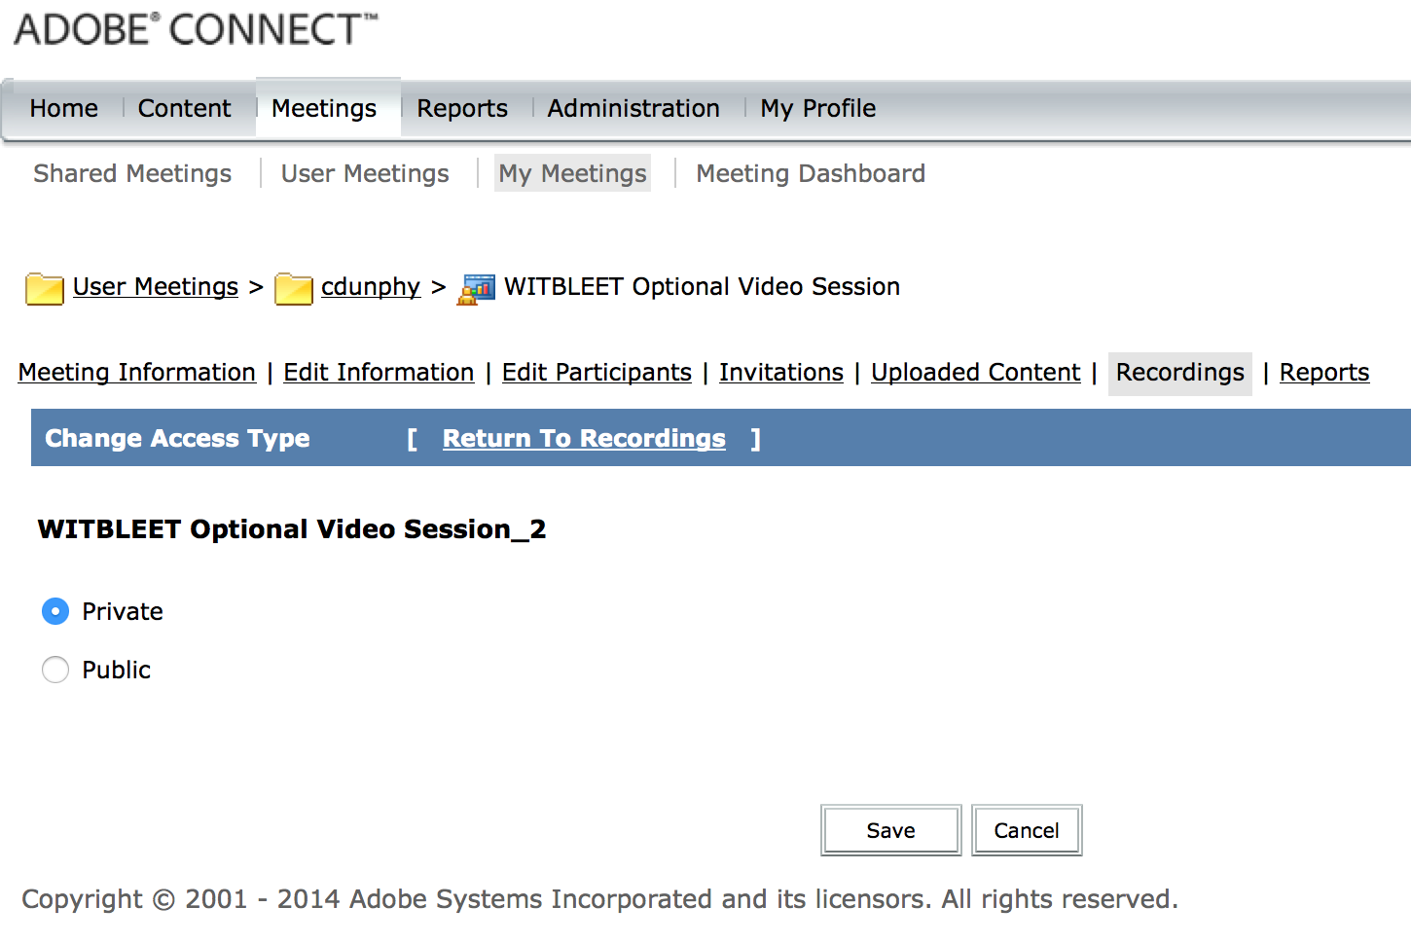
2
1
3
Make Recordings Public
4
Notes:
To make meetings available to public, Seclect Manage Meeting, choose the recordingPress “Access Type” then “Public” and Save

Slide 21
Stop Recording! Finish Session
Thanks Everyone
See you f2f tomorrow

